Slide 1
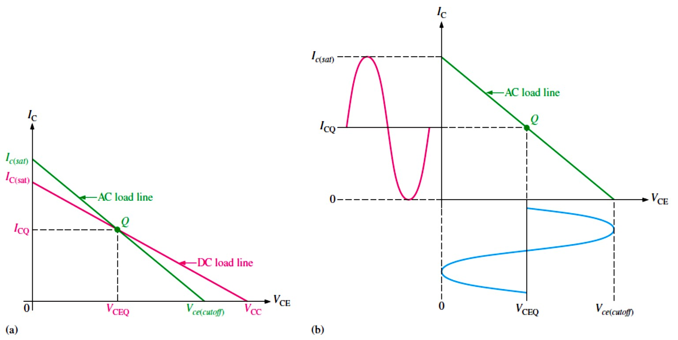
Lecture 7: Power Amplifiers
Power amplifiers are those amplifiers that have the objective of delivering power to a load.
This means that components must be considered in terms of their ability to dissipate heat.
Power amplifiers are large-signal amplifiers.
This generally means that a much larger portion of the load line is used during signal operation than in a small-signal amplifier.
In this Lecture, we will cover four classes of power amplifiers: class A, class B, class AB, and class C.
Power amplifiers are normally used as the final stage of a communications receiver or
transmitter to provide signal power to speakers or to a transmitting antenna.
7.1 The Class A Power Amplifier
A class A power amplifier operates entirely in the linear region of the transistor’s characteristic curves. The transistor conducts during the full 360° of the input cycle.
The Q-point must be centered on the load line for maximum class A output signal swing as shown in Figure 7-1.
FIGURE 7-1: Maximum class A output occurs when the Q-point is centered on the ac load line.
Power Gain: The power gain of an amplifier is the ratio of the output power (power delivered to the load) to the input power. In general, power gain is
𝑨� = 𝑷_{𝑳}⁄𝑷_{𝒊�}
Equation 7– 1
where 𝐴� is the power gain, �_{𝐿}is signal power delivered to the load, and �_{𝑖�} is signal power delivered to the amplifier.
The power gain of an amplifier in terms of voltage gain is
𝑨� = 𝑨��(𝑹_{𝒊�}⁄𝑹_{𝑳})
Equation 7– 2

Slide 2
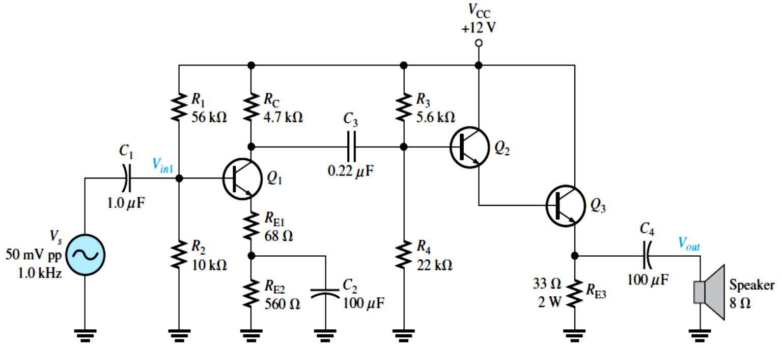
DC Quiescent Power: The power dissipation of a transistor with no signal input is the product of its Q-point current and voltage.
^{𝑷}��^{= 𝑰}��^{𝑽}��𝐐
Equation 7– 3
The dc quiescent power is the maximum power that a class A amplifier must handle.
The transistor’s power rating must exceed this value.
Output Power: To find the maximum signal power output, we use the rms values of maximum current and voltage. The maximum power out from a class A amplifier is
����(�𝑎𝑥) ^{= (0.707𝐼}𝑐(�𝑎𝑥)^{)(0.707�}𝑐(�𝑎𝑥)⁾
^{𝑷}���(�𝒂𝒙) ^{= �. 𝟓𝑰}��^{𝑽}��𝐐
Equation 7– 4
EXAMPLE 7-1: Determine the voltage gain and the power gain of the class A power amplifier in Figure 7-2. Assume 𝛽_{𝑎�}= 200 for all transistors.
FIGURE 7-2
Solution The first stage (�₁) is a voltage-divider biased common-emitter with a swamping resistor (�_{E1}). The second stage (�₂ and �₃) is a Darlington voltage-follower configuration. The speaker is the load.
First stage: The ac collector resistance of the first stage is �_{C} in parallel with the input resistance to the second stage.
�_{𝑐1} ≅ �_{C} ∥ (�₃ ∥ �₄) = 4.7 kΩ ∥ 5.6 kΩ ∥ 22 kΩ = 2.29 kΩ
The voltage gain of the first stage is the ac collector resistance, �_{𝑐1}, divided by the ac emitter resistance, which is the sum of �_{E1} + �′_{𝑒(𝑄1)}.The approximate value of �′_{𝑒(𝑄1)} is determined by
first finding 𝐼_{E}.
�_{B} ≅ (�₂⁄(�₁ + �₂))�_{CC} = (10 kΩ⁄(10 kΩ + 56 kΩ))12 V = 1.82 V
�_{BE} = �_{B} − �_{E}
�_{E} = �_{B} − �_{BE} = �_{B} − 0.7 V = 1.82 V − 0.7 V = 1.12 V
𝐼_{E} = �_{E}⁄(�_{E1} + �_{E2}) = 1.12 V⁄(68 Ω + 560 Ω) = 1.78 mA

Slide 3
�′_{𝑒(𝑄1)} = 25 mV⁄𝐼_{E} = 25 mV⁄1.78 mA = 14 Ω
The voltage gain of the first stage with the loading of the second stage taken into account.
𝐴_{�1} = − �_{𝑐1}⁄�_{E1} + �′_{𝑒(𝑄1)} = − 2.29 kΩ⁄(68 Ω + 14 Ω) = −27.9
The negative sign is for inversion.
The total input resistance of the first stage is equal to the bias resistors in parallel with the ac input resistance at the base of �₁.
�_{𝑖�(���)1} = �₁ ∥ �₂ ∥ 𝛽_{𝑎�(𝑄1)}(�_{E1} + �′_{𝑒(𝑄1)}) = 56 kΩ ∥ 10 kΩ ∥ 200(68 Ω + 14 Ω) = 8.4 kΩ
Second stage: The voltage gain of the darlington emitter-follower is approximately equal to 1.
𝐴_{�2} ≅ 1
Overall amplifier: The overall voltage gain is the product of the first and second stage voltage gains. Since the second stage has a gain of approximately 1, the overall gain is approximately
equal to the gain of the first stage.
𝐴_{�(���)} = 𝐴_{�1}𝐴_{�2} = (−27.9)(1) = −27.9
Power gain: The power gain of the amplifier can be calculated using Equation 7-2.
𝐴� = 𝐴²_{�(���)}(�_{𝑖�(���)1}⁄�_{𝐿}) = (−27.9)²(8.4 kΩ⁄8 Ω) = 817,330
Efficiency: The efficiency of any amplifier is the ratio of the output signal power supplied to a load to the total power from the dc supply.
The maximum efficiency, 𝜂_{max}, of a capacitively coupled class A amplifier is
𝜂_{max} = ���� ⁄�_{DC} = (0.5𝐼_{CQ}�_{CEQ})⁄(2𝐼_{CQ}�_{CEQ}) = 0.25
The maximum efficiency of a capacitively coupled class A amplifier is 0.25, or 25%.
The low efficiency of class A amplifiers limits their usefulness to small power applications that require usually less than 1 W.
EXAMPLE 7-2: Determine the efficiency of the power amplifier in Figure 7-2 (Example 7-1).
Solution The input voltage �_{𝑖�} = 50 mV peak-to-peak
�_{𝑖�(rms)} = 0.707 �_{𝑖�} = (0.707)(50 mV) = 35.4 mV
The input power is, therefore, �_{𝑖�} = �_{𝑖�}²⁄�_{𝑖�} = (35.4 mV)²⁄8.4 kΩ = 149 nW
The output power is
���� = �_{𝑖�}𝐴� = (149 nW)(817,330) = 122 mW
Most of the power from the dc source is supplied to the output stage. The current in the output stage can be computed from the dc emitter voltage of �₃.
�_{B(Q2)} ≅ (�₄⁄(�₃ + �₄))�_{CC} = (22 kΩ⁄(5.6 kΩ + 22 kΩ))12 V = 9.6 V
^{2�}BE ^{= �}B(Q2) ^{− �}E(Q3)
�_{E(Q3)} = �_{B(Q2)} − 2�_{BE} = 9.6 V − 2(0.7 V) = 8.2 V
𝐼_{E(Q3)} = �_{E(Q3)}⁄�_{E3} = 8.2 V⁄33 Ω = 0.25 A

Slide 4
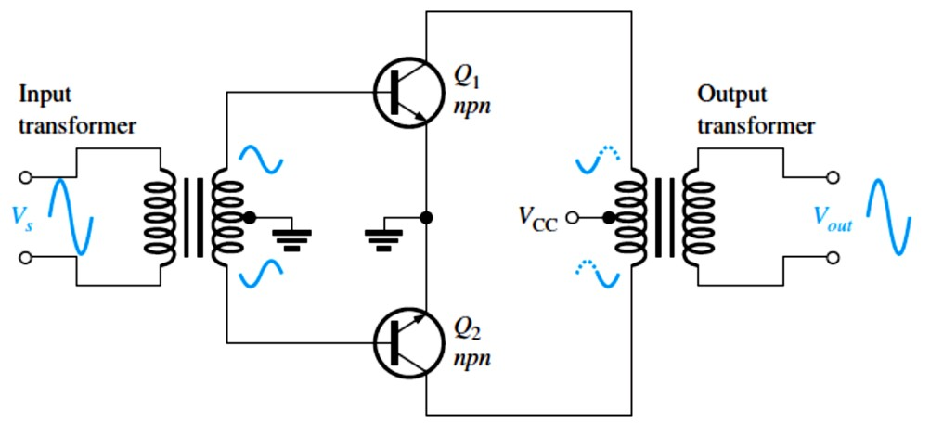
Neglecting the other transistor and bias currents, which are very small, the total dc supply current
𝐼_{CC} ≅ 𝐼_{E(Q3)} = 0.25 A.
The power from the dc source is
�_{DC} = 𝐼_{CC}�_{CC} = (0.25 A)(12 V) = 3 W
Therefore, the efficiency of the amplifier for this input is
𝜂_{max} = ���� ⁄�_{DC} = 122 mW⁄3 W ≅ 0.04
This represents 4%efficiency illustrates why class A is not a good choice for a power amplifier.
7.2 The Class B and Class AB Push-Pull Amplifiers
A class B amplifier operates in the linear region for 180° of the input cycle and is in cutoff for 180°.
The primary advantage of a class B or class AB amplifier over a class A amplifier is that either one is more efficient than a class A amplifier.
A disadvantage of class B or class AB is that it is more difficult to implement the circuit in
order to get a linear reproduction of the input waveform.
The Q-point is at cutoff for class B amplifier so that 𝐼_{CQ} = 0 and �_{CEQ} = �_{CE(cutoff)}.
Class B amplifiers are normally operated in a push-pull configuration in order to produce an output that is a replica of the input.
There are two common approaches for using push-pull amplifiers.
The first approach uses transformer coupling.
The second uses two complementary symmetry transistors; these are a matching pair of
npn/pnp BJTs.
The maximum efficiency of a class B amplifier is 79%.
Transformer Coupling: Transformer coupling is illustrated in Figure 7-3. The input transformer has a center-tapped secondary that is connected to ground, producing phase
inversion of one side with respect to the other. The input transformer thus converts the input signal to two out-of-phase signals for the transistors. Both transistors are npn types. Because of the signal inversion, �₁ will conduct on the positive part of the cycle and �₂ will conduct
on the negative part. The output transformer combines the signals by permitting current in both directions, even though one transistor is always cut off. The positive power supply signal is connected to the center tap of the output transformer.
FIGURE 7-3: Transformer-coupled push-pull amplifiers. �₁ conducts during the positive half-cycle;
�₂ conducts during the negative half-cycle. The two halves are combined by the output transformer.

Slide 5
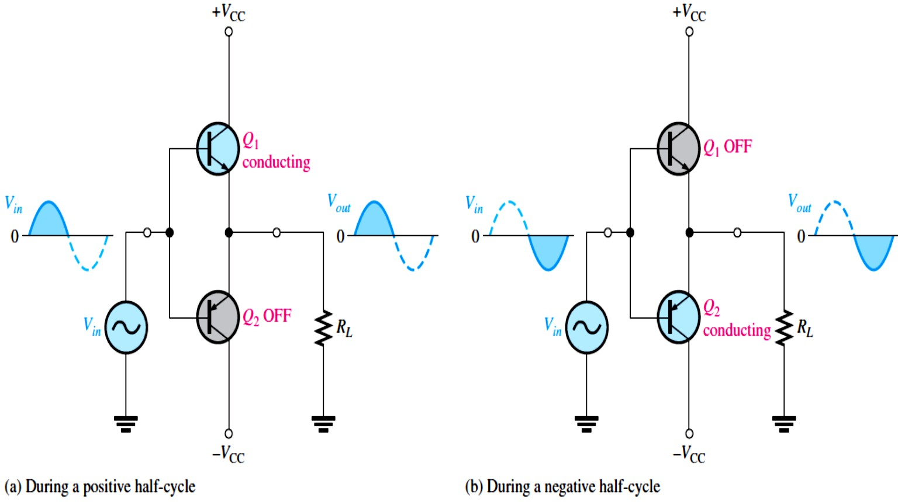
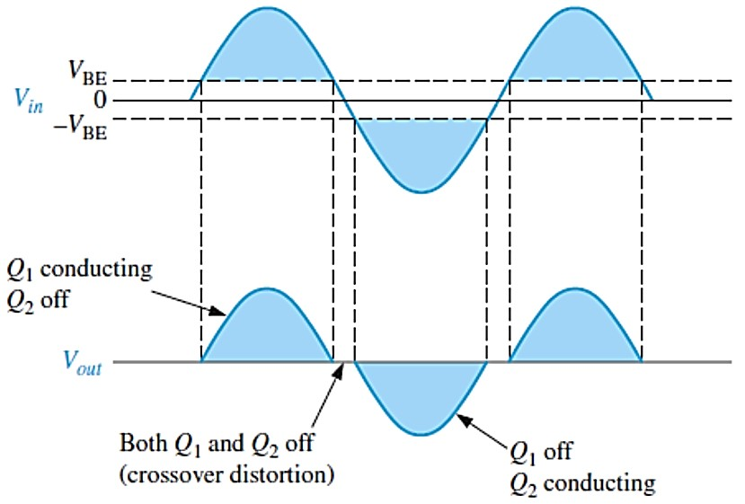
Complementary Symmetry Transistors: Figure 7-4 shows one of the most popular types of push-pull class B amplifiers using two emitter-followers and both positive and negative power supplies. This is a complementary amplifier because one emitter-follower uses an npn transistor and the other a pnp, which conduct on opposite alternations of the input cycle. There is no dc base bias voltage (�_{B} = 0). Thus, only the signal voltage drives the transistors into conduction. Transistor �₁ conducts during the positive half of the input cycle, and �₂ conducts during the negative half.
FIGURE 7-4: Class B push-pull ac operation.
Crossover Distortion: When the dc base voltage is zero, both transistors are off and the input signal voltage must exceed �_{BE} before a transistor conducts. Because of this, there is a time interval between the positive and negative alternations of the input when neither transistor is conducting, as shown in Figure 7-5. The resulting distortion in the output waveform is called crossover distortion.
FIGURE 7-5: Illustration of crossover distortion in a class B push-pull amplifier. The transistors conduct only during portions of the input indicated by the shaded areas.

Slide 6
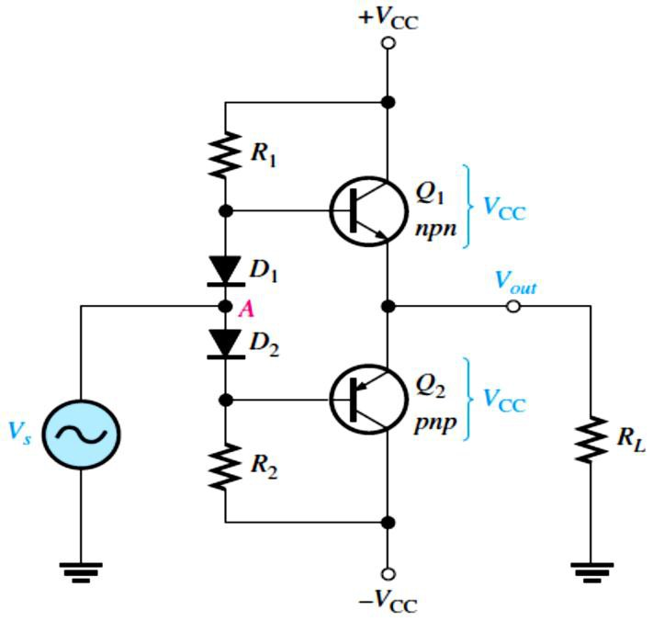
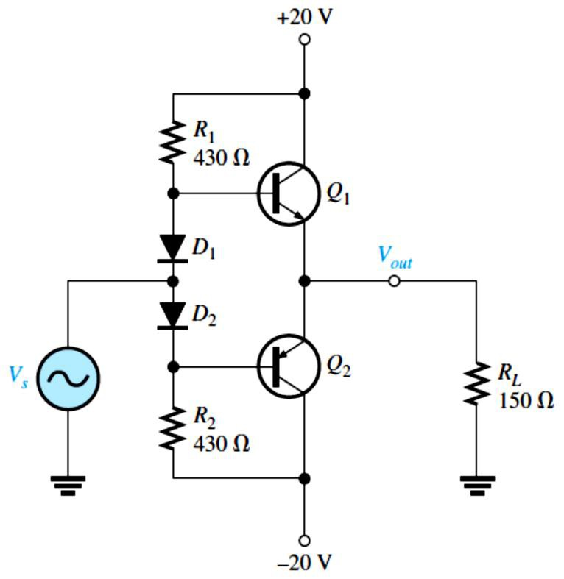
Biasing the Push-Pull Amplifier for Class AB Operation: A class AB amplifier, as shown in Figure 7-6, is biased slightly above cutoff and operates in the linear region for slightly more than 180° of the input cycle.
Class AB eliminates crossover distortion found in pure class B.
FIGURE 7-6: Biasing the push-pull amplifier with
current-mirror diode bias to eliminate crossover distortion.
The transistors form a complementary pair (one npn and one pnp)
AC Operation: The ac saturation current for a two-supply operation with the class AB push- pull amplifier in Figure 7-6 is
^{𝑰}𝒄(�𝒂�) ^{= 𝑽}��^{⁄𝑹}𝑳
Equation 7– 5
EXAMPLE 7–3: Determine the ideal maximum peak output voltage and current for the circuit shown in Figure 7-7.
FIGURE 7-7
Solution The ideal maximum peak output voltage is
����(�𝑒𝑎𝑘) ≅ �CEQ ≅ �CC ^{= 20 V}
The ideal maximum peak current is
�CC
^{𝐼}���(�𝑒𝑎𝑘) ^{≅ 𝐼}𝑐(�𝑎�) ≅ �
𝐿
20 V
^{𝐼}���(�𝑒𝑎𝑘) ⁼ _{150 Ω} ^{= 133 mA}
The actual maximum values of voltage and current are slightly smaller.
Single-Supply Push-Pull Amplifier: Push-pull amplifiers using complementary symmetry transistors, as shown in Figure 7-8, can be operated from a single voltage source.

Slide 7
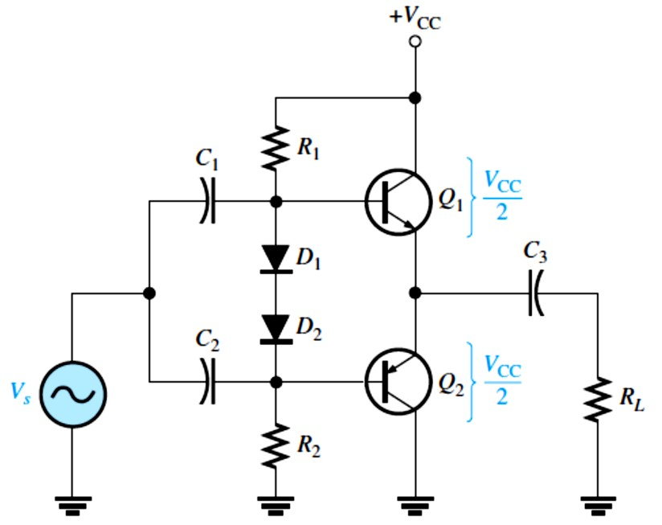
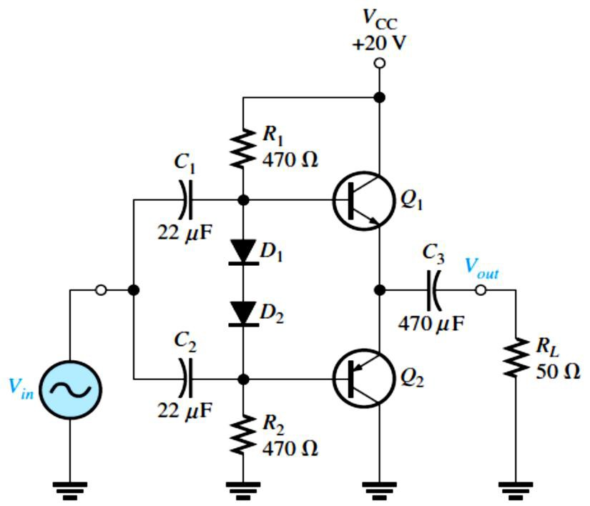
FIGURE 7-8: Single-ended push-pull amplifier.
EXAMPLE 7-4: Determine the maximum ideal peak values for the output voltage and current in Figure 7-9.
FIGURE 7-9
Solution The maximum peak output voltage is
����(�𝑒𝑎𝑘) ≅ �CEQ ≅
����(�𝑒𝑎𝑘) ^{= 10 V}
�CC
=
20 V
2 2
The maximum peak output current is
^{𝐼}���(�𝑒𝑎𝑘) ^{≅ 𝐼}𝑐(�𝑎�) ≅
�CEQ
�
𝐿
10 V
^{𝐼}���(�𝑒𝑎𝑘) ⁼ _{50 Ω} ^{= 200 mA}
Class B/AB Power: The maximum average output power is
^{𝑷}��� ^{= �. ��𝑰}𝒄(�𝒂�)^{𝑽}��
Equation 7– 6
Efficiency An advantage of push-pull class B and class AB amplifiers over class A is a much higher efficiency.
The maximum efficiency, 𝜂_{max}, for a class B amplifier (class AB is slightly less) is
𝜂_{max} = ���� ⁄�_{DC} = (0.25 𝐼_{𝑐(�𝑎�)}�_{CC})⁄(𝐼_{𝑐(�𝑎�)}�_{CC} ⁄𝜋) = 0.25𝜋
𝜼_{𝐦𝐚𝐱}= �. 𝟕�
or, as a percentage, 𝜂_{max} = 79%.
𝐸��𝑎�𝑖�� 7– 7
EXAMPLE 7–5: Find the maximum ac output power and the dc input power of the amplifier in Figure 7-10.

Slide 8
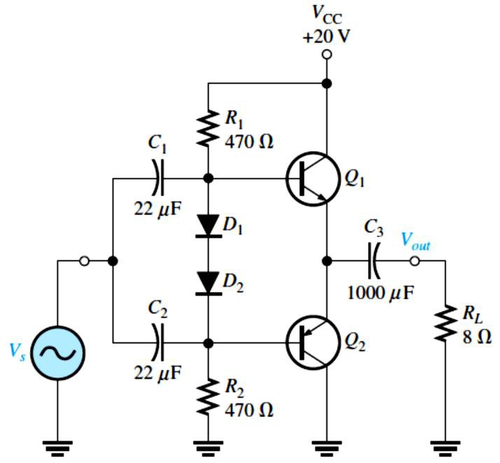
Solution The ideal maximum peak output voltage is
FIGURE 7-10
�CC
20 V
����(�𝑒𝑎𝑘) ≅ �CEQ ≅
= = 10 V
2 2
The maximum peak output current is
^{𝐼}���(�𝑒𝑎𝑘) ^{≅ 𝐼}𝑐(�𝑎�) ≅
�CEQ
10 V
= _{8 Ω} = 1.25 A
�
𝐿
The ac output power and the dc input power are
���� = 0.25 𝐼_{𝑐(�𝑎�)}�_{CC} = 0.25(1.25 A)(20 V) = 6.25 W
�_{DC} =
^{𝐼}𝑐(�𝑎�)�CC
(1.25 A)(20 V)
𝜋
= = 7.96 W
𝜋
Input Resistance: The complementary push-pull configuration used in class B/class AB amplifiers is, in effect, two emitter-followers.
The input resistance for the emitter-follower, where �₁ and �₂ are the bias resistors, is
�_{𝑖�} = 𝛽_{𝑎�}(�′_{𝑒}+ �_{E}) ∥ �₁ ∥ �₂
Since �_{E} = �_{𝐿}, the formula is
𝑹_{𝒊�} = 𝜷_{𝒂�}(�′_{𝒆}+ 𝑹_{𝑳}) ∥ 𝑹� ∥ 𝑹�
Equation 7– 8
EXAMPLE 7–6: Assume that a preamplifier stage with an output signal voltage of 3 V rms and an output resistance of 50 Ω is driving the push-pull power amplifier in Figure 7-10 (Example 7- 5). �₁ and �₂ in the power amplifier have a 𝛽_{𝑎�}of 100 and an �′_{𝑒}of 1.6 Ω. Determine the loading effect that the power amplifier has on the preamp stage.
Solution Looking from the input signal source, the bias resistors appear in parallel because both go to ac ground and the ac resistance of the forward-biased diodes is very small and can be ignored. The input resistance at the emitter of either transistor is 𝛽_{𝑎�}(�′_{𝑒}+ �_{𝐿}).So, the signal source sees �₁, �₂, and 𝛽_{𝑎�}(�′_{𝑒}+ �_{𝐿}) all in parallel.
The ac input resistance of the power amplifier is
�_{𝑖�} = 𝛽_{𝑎�}(�′_{𝑒}+ �_{𝐿}) ∥ �₁ ∥ �₂ = 100(1.6 Ω + 8 Ω) ∥ 470 Ω ∥ 470 Ω = 188 Ω
Obviously, this will have an effect on the preamp driver stage. The output resistance of the preamp stage and the input resistance of the power amp effectively form a voltage divider that reduces the output signal from the preamp. The actual signal at the power amp is
�_{𝑖�} = (�_{𝑖�}⁄(�� + �_{𝑖�}))�� = (188 Ω⁄(50 Ω + 188 Ω))3 V = 2.37 V
Darlington Class AB Amplifier: In many applications where the push-pull configuration is used, the load resistance is relatively small. For example, an 8 Ω speaker is a common load for a class AB push-pull amplifier.

Slide 9
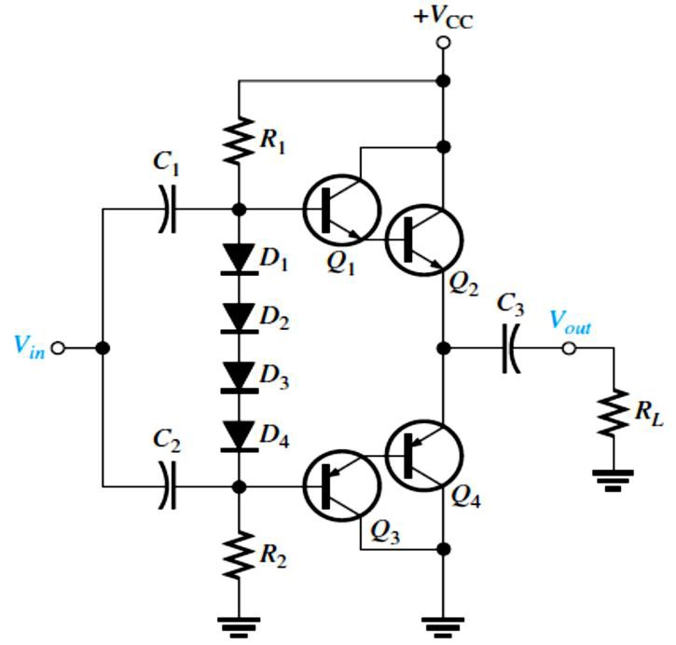
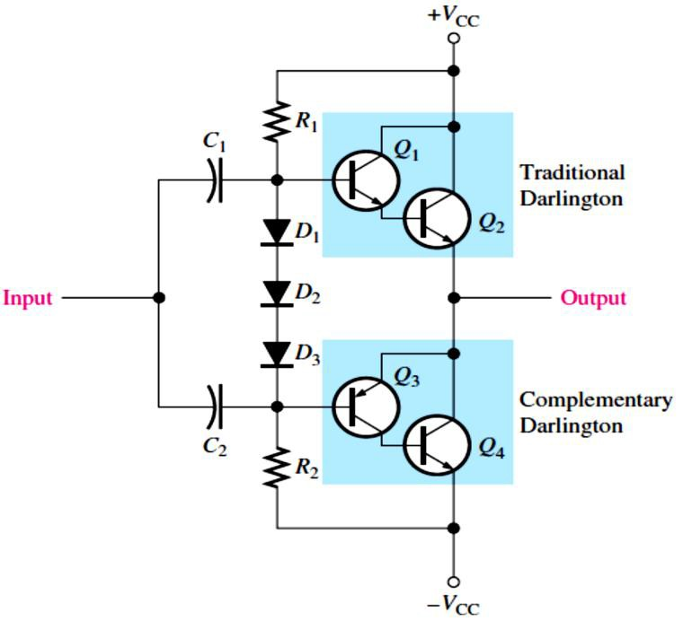
Depending on the output resistance of the preceding amplifier, the low push-pull input resistance can load it severely and significantly reduce the voltage gain.
In certain applications with low-resistance loads, a push-pull amplifier using Darlington transistors can be used to increase the input resistance presented to the driving amplifier and avoid severely reducing the voltage gain.
The overall ac beta of a Darlington pair is generally in excess of a thousand. Also, the bias resistors can be greater because less base current is required.
A Darlington class AB push-pull amplifier is shown in Figure 7-11. Four diodes are required in the bias circuit to match the four base-emitter junctions of the two Darlington pairs.
FIGURE 7-11: A Darlington class AB push-pull amplifier.
Darlington/Complementary Darlington Class AB Amplifier: is shown in Figure 7-12.
The complementary Darlington, also known as the Sziklai pair. It is similar to the traditional Darlington pair except it uses complementary transistors (one npn and one pnp).
The complementary Darlington is used when it is determined that output power transistors of the same type should be used (both npn or both pnp).
FIGURE 7-12: A Darlington/complementary Darlington class AB push-pull amplifier.

Slide 10
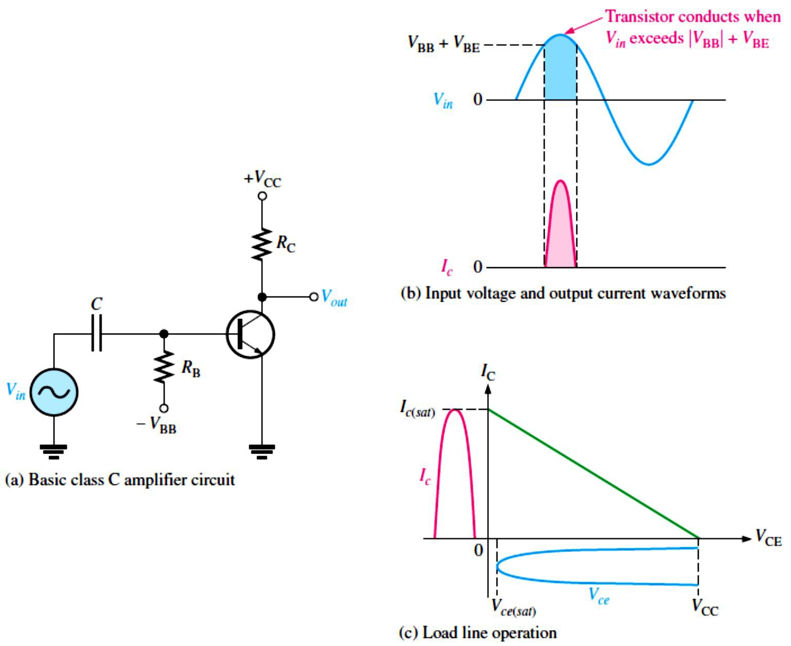
7.3 The Class C Amplifier
A class C amplifier, shown in Figure 7-13, operates in the linear region for only a small part of the input cycle.
FIGURE 7-13: Basic class C amplifier operation (noninverting).
Class C amplifier, shown in Figure 7-14, is more efficient than either class A or push-pull class B and class AB, which means that more output power can be obtained from class C.
The output amplitude is a nonlinear function of the input, so
class C amplifiers are not used for linear amplification.
They are generally used in radio frequency (RF) applications, including circuits, such as oscillators, that have a constant output amplitude, and modulators, where a high-frequency
signal is controlled by a low-frequency signal.
The class C amplifier is biased below cutoff.
FIGURE 7-14: Basic class C operation.
Power Dissipation: The power dissipation of the transistor in a class C amplifier is low because it is on for only a small percentage of the input cycle.
The power dissipation during the on time is, therefore, �_{D(on)} = 𝐼_{𝑐(�𝑎�)}�_{𝑐�(�𝑎�)}
The transistor is on for a short time, �_{on}, and off for the rest of the input cycle. Therefore, assuming the entire load line is used, the power dissipation averaged over the entire cycle is
�D(avg) ^{= (�}on^{⁄𝑇)�}D(on) ^{= (�}on^{⁄𝑇)𝐼}𝑐(�𝑎�)�𝑐�(�𝑎�)
10

Slide 11
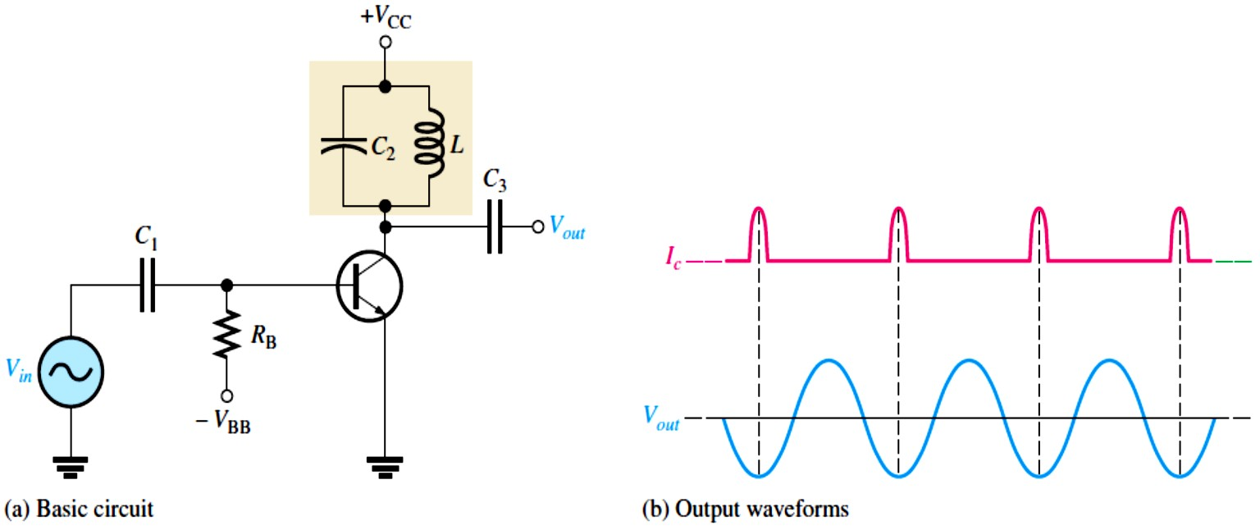
EXAMPLE 7-7: A class C amplifier is driven by a 200 kHz signal. The transistor is on for 1 𝜇s, and the amplifier is operating over 100 percent of its load line. If 𝐼_{𝑐(�𝑎�)} = 100 mA and �_{𝑐�(�𝑎�)} =
0.2 V, what is the average power dissipation of the transistor?
Solution The period is 𝑇= 1⁄𝑓= 1⁄200 kHz = 5 𝜇s
Therefore, �_{D(avg)} = (�_{on}⁄𝑇)𝐼_{𝑐(�𝑎�)}�_{𝑐�(�𝑎�)} = (1 𝜇s⁄5 𝜇s)(100 mA)(0.2 V) = 4 mW
The low power dissipation of the transistor operated in class C is important because, as we will see later, it leads to a very high efficiency when it is operated as a tuned class C amplifier in which relatively high power is achieved in the resonant circuit.
Tuned Operation: Class C amplifiers, as shown in Figure 7-15, are normally operated as
tuned amplifiers to produce a sinusoidal output.
It is necessary to use a class C amplifier with a parallel resonant circuit (tank).
FIGURE 7-15: Tuned
class C amplifier.
The resonant frequency of the tank circuit is determined by the formula: �� = 1⁄2𝜋√𝐿�
Maximum Output Power: Since the voltage developed across the tank circuit has a peak-to- peak value of approximately 2�_{CC}, the maximum output power can be expressed as
���� = 𝑉²���⁄�_{𝑐}= (0.707 �_{CC})²⁄�_{𝑐}
𝑷��� = �. 𝟓𝑽���⁄𝑹_{𝒄}
Equation 7– 9
�_{𝑐}is the equivalent parallel resistance of the collector tank circuit at resonance and represents the parallel combination of the coil resistance and the load resistance. It usually has a low value.
The total power that must be supplied to the amplifier is �_{T} = ���� + �_{D(avg)}
Therefore, the efficiency is
^{𝜼= 𝑷}���^{⁄𝑷}𝐓^{= 𝑷}���^{⁄(𝑷}��� ^{+ 𝑷}�(𝐚𝐯𝐠)⁾
Equation 7– 10
When ���� ≫ �_{D(avg)}, the class C efficiency closely approaches 1 (100 %).
11

Slide 12
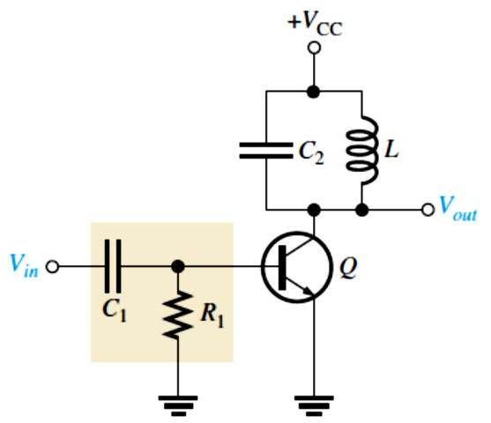
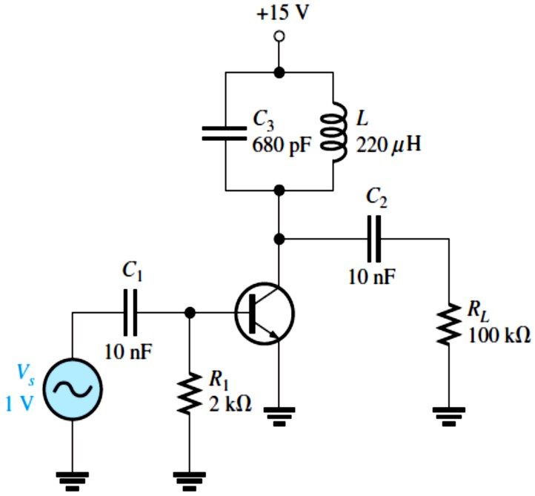
The maximum efficiency of a class C amplifier is higher than that of either class A or class B amplifiers.
Under conditions of low power dissipation and high output power, the efficiency can approach 100 %.
EXAMPLE 7–8: Suppose the class C amplifier described in Example 7-7 has a �_{CC} equal to 24 V and the �_{𝑐}is 100 Ω. Determine the efficiency.
Solution The period is 𝑇= 1⁄𝑓= 1⁄200 kHz = 5 𝜇s
Therefore, �_{D(avg)} = (�_{on}⁄𝑇)𝐼_{𝑐(�𝑎�)}�_{𝑐�(�𝑎�)} = (1 𝜇s⁄5 𝜇s)(100 mA)(0.2 V) = 4 mW
���� = 0.5 �_{CC}²⁄�_{𝑐}= 0.5(24 V)²⁄100 Ω = 2.88 W
Therefore, 𝜂= ���� ⁄(���� + �_{D(avg)}) = 2.88 W⁄(2.88 W + 4 mW) = 0.999
or, as a percentage, 99.9%.
Clamper Bias for a Class C Amplifier: Figure 7-16 shows a class C amplifier with a base bias clamping circuit.
The base-emitter junction functions as a diode.
FIGURE 7-16: Tuned class C amplifier with clamper bias.
EXAMPLE 7–9: Determine the voltage at the base of the transistor, the resonant frequency, and the peak-to-peak value of the output signal voltage for the class C amplifier in Figure 7-17.
FIGURE 7-17
Solution
�_{�(�)} = 1.414 �_{�(���)} = (1.414)(1 V)
�_{�(�)} ≅ 1.4 V
The base is clamped at −(�_{�(�)} − 0.7 V) = −0.7 V dc
The signal at the base has a positive peak of +0.7 V and a negative peak of
−�_{�(�)} + (−0.7 V) = −1.4 V − 0.7 V
−�_{�(�)} + (−0.7 V) = −2.1 V
The resonant frequency is �� = 1⁄2𝜋√𝐿�
= 1⁄(2𝜋√(220 𝜇H)(680 pF)) = 411 kHz
The output signal has a peak-to-peak value of ��� = 2�_{CC} = 2(15 V) = 30 V
12

